Slide 1

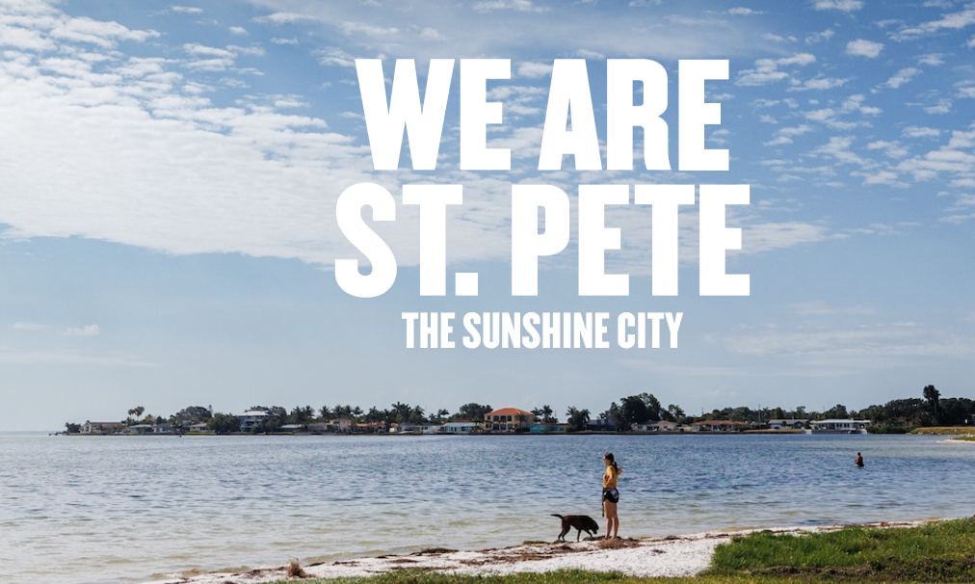
Economic Impact of Wildfires on Tourism in
St. Petersburg

Slide 2
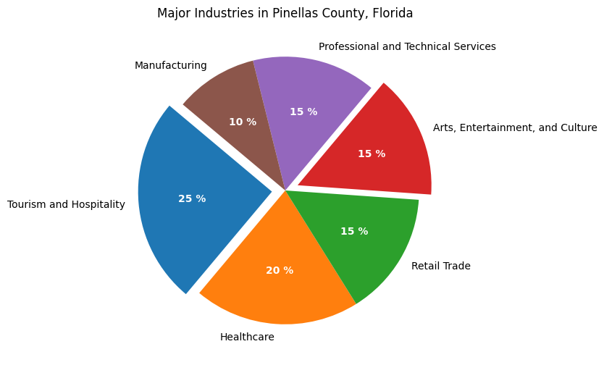

More than 15.8 million visitors to Pinellas County contributed $6.6 billion in direct visitor spending in 2023

Slide 3
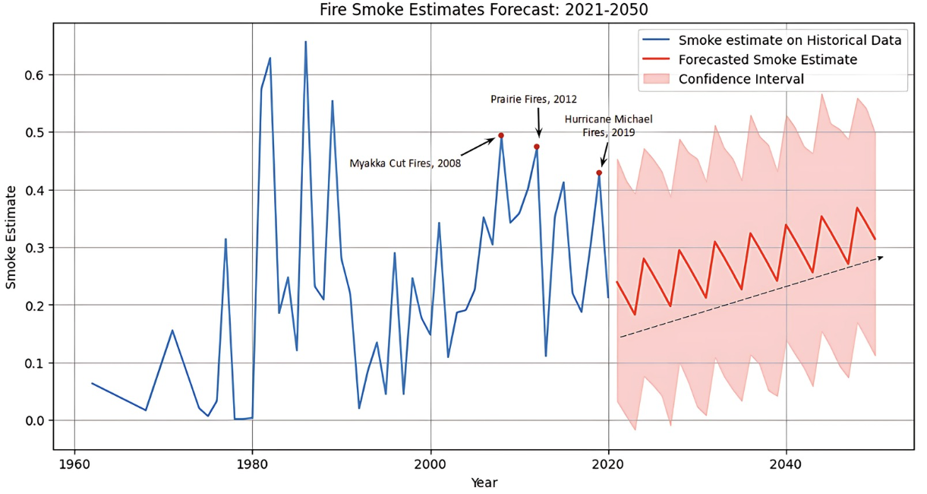

Slide 4



Slide 5
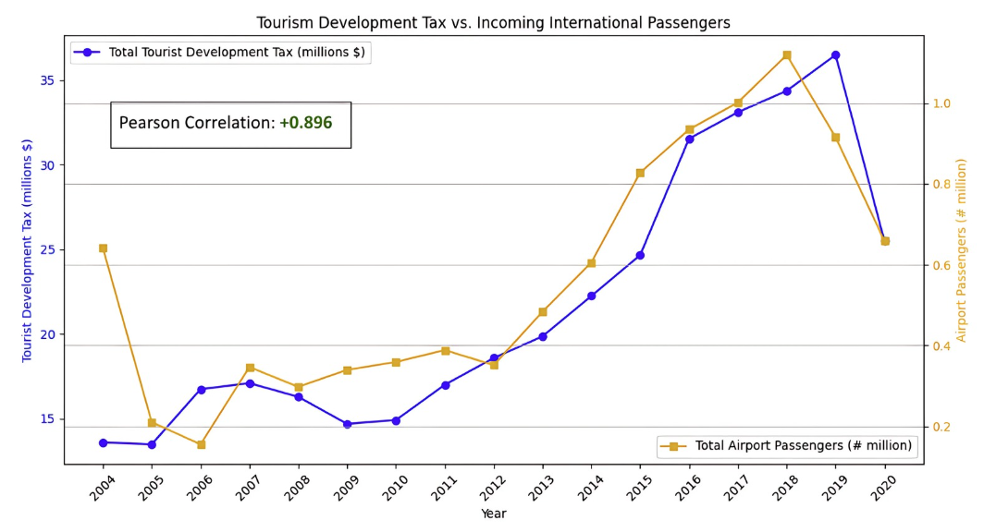

Slide 6
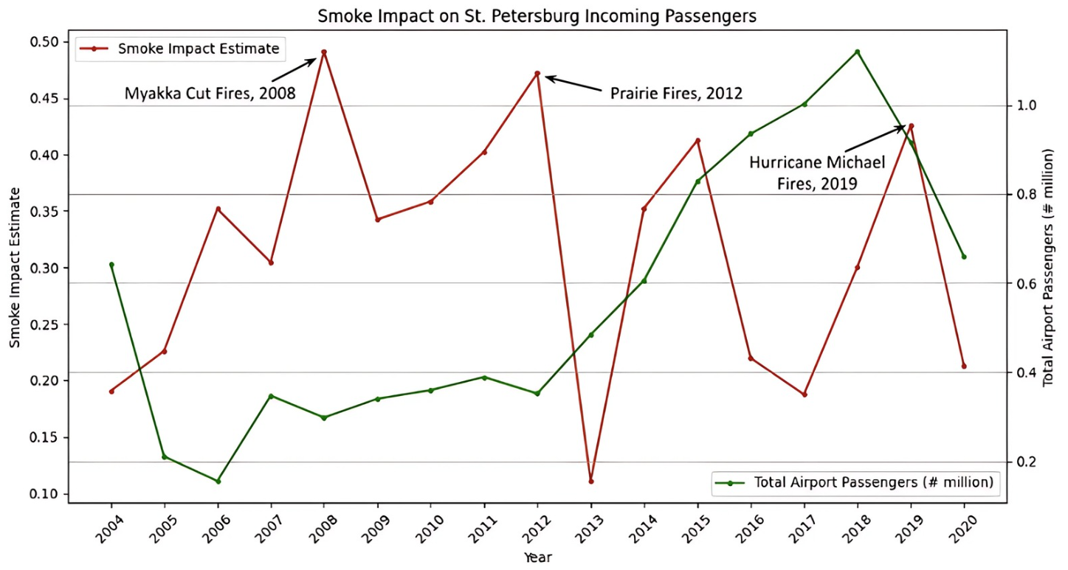

Slide 7
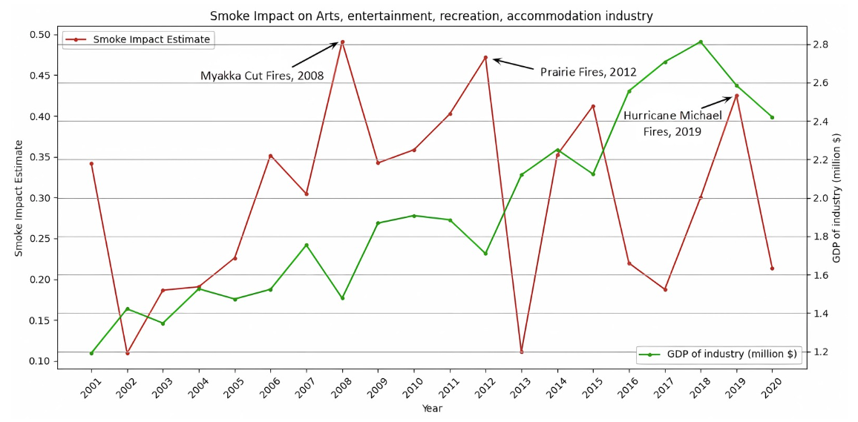

Pearson Correlation: - 0.25

Slide 8




Slide 9
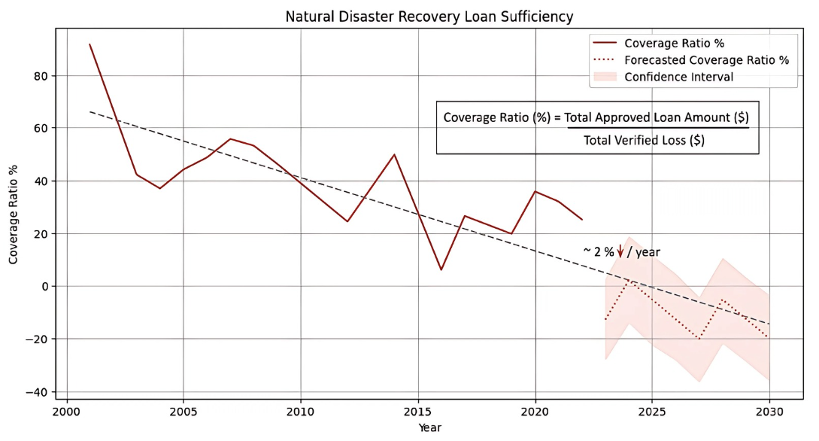

Slide 10

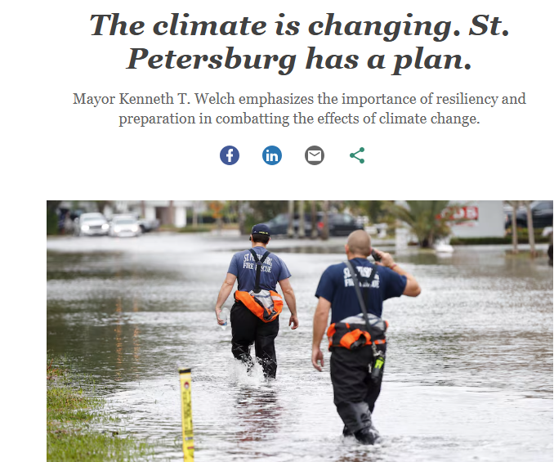

Recovery and Mitigation Strategies
Improved access to credit
Better emergency relief funds
Diversifying tourism offerings
Digital transition of cultural presence
Alternate revenue streams at airports
Enhanced monitoring and awareness for Air Quality control

